Slide 1
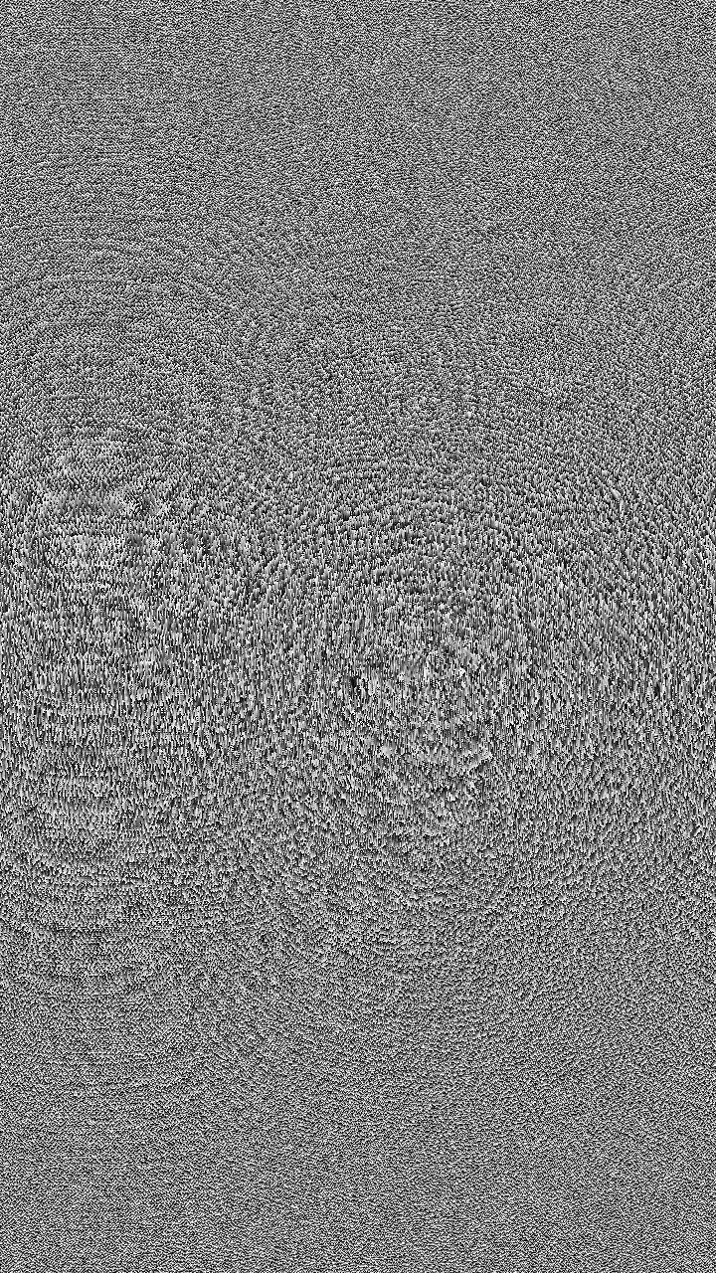
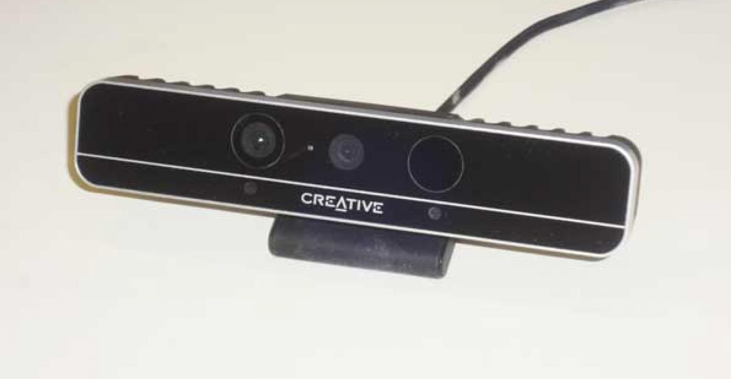
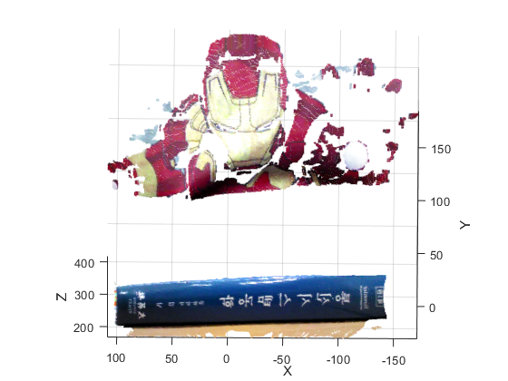
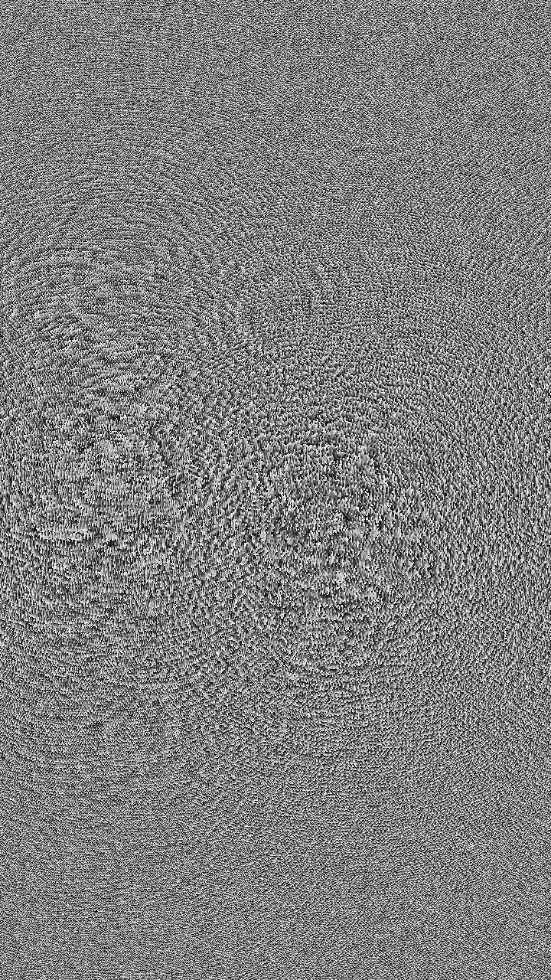
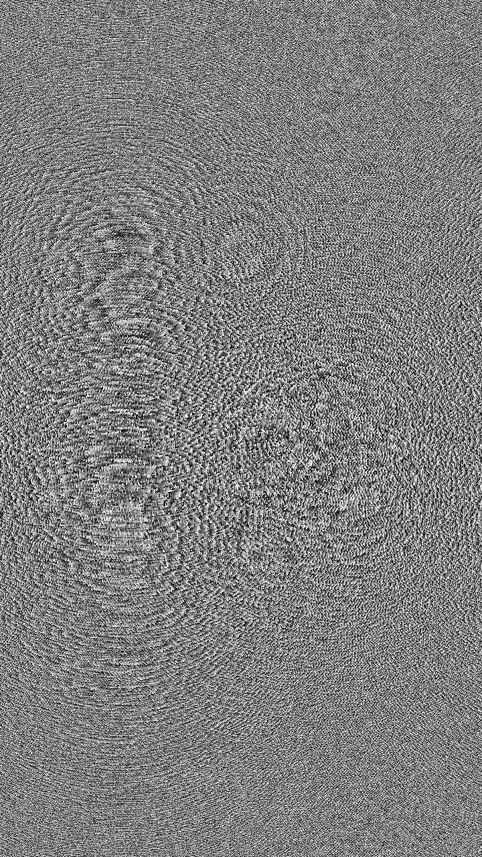
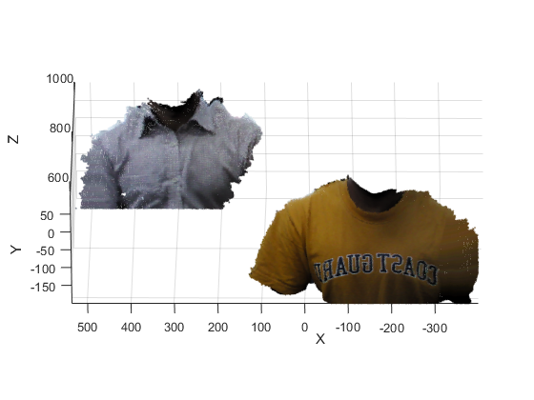
R
G
ROI
B
a)
b)
c)
R
G
ROI
B
a)
b)
c)

Slide 2
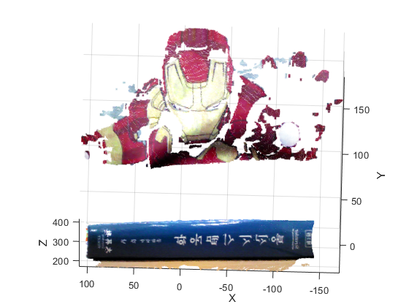
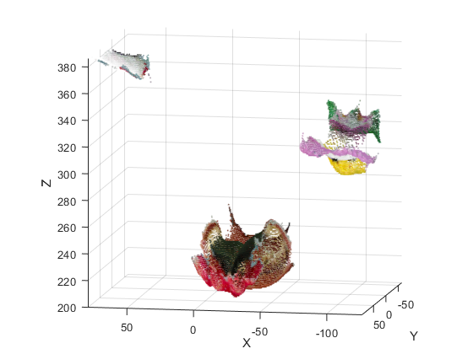
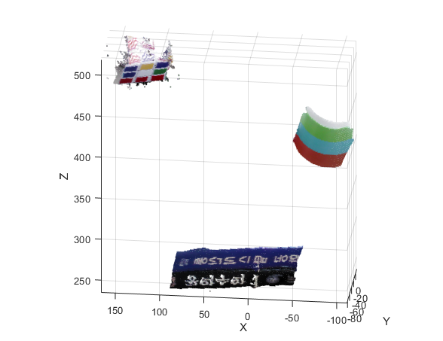
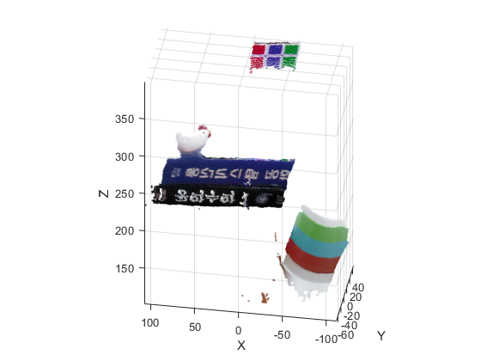




a) Scene 1
b) Scene 2
c) Scene 3

Slide 3
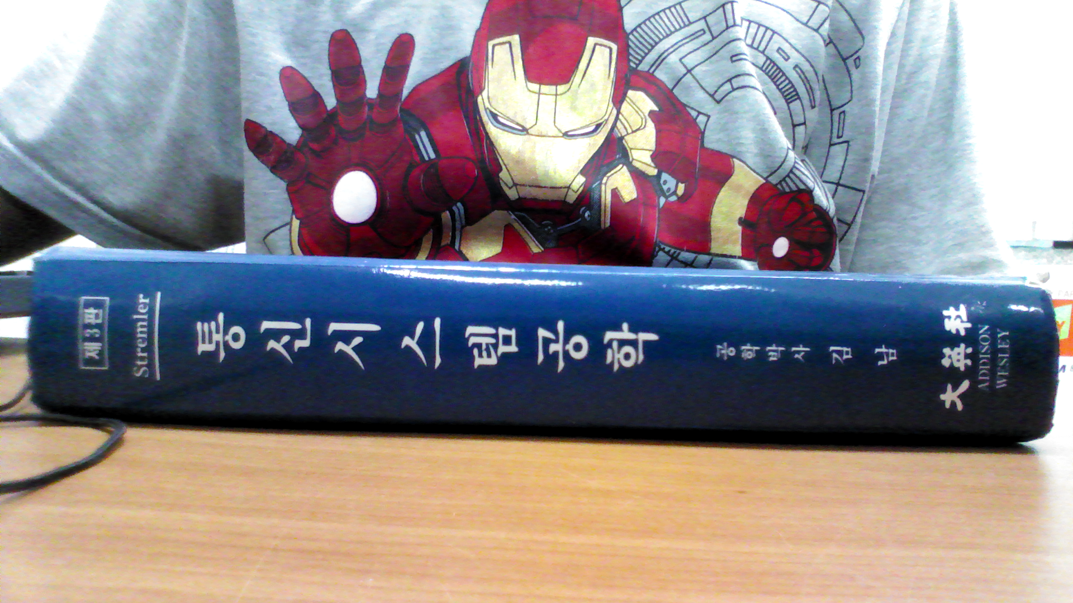
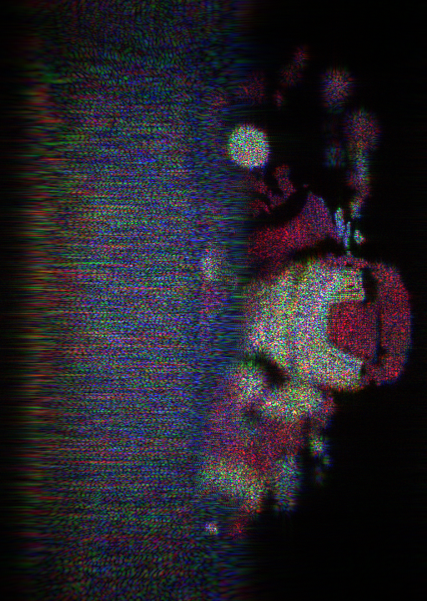
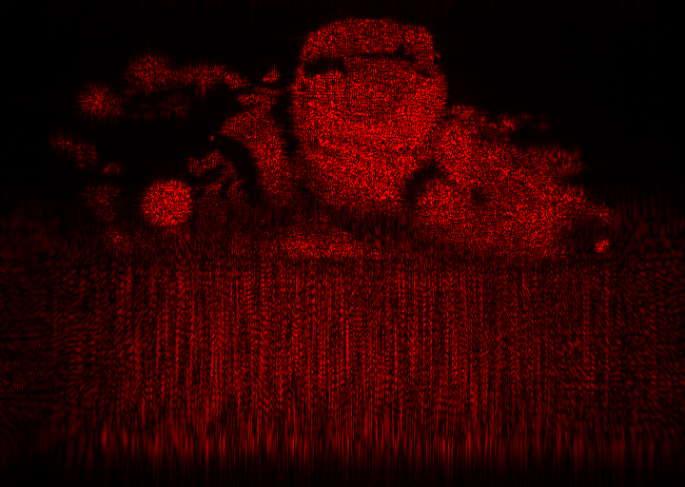
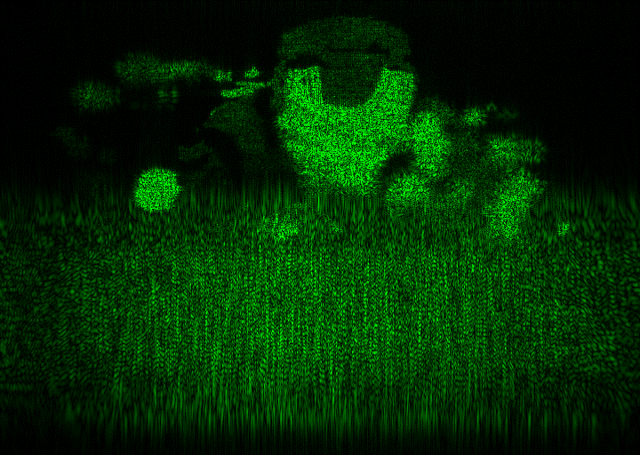
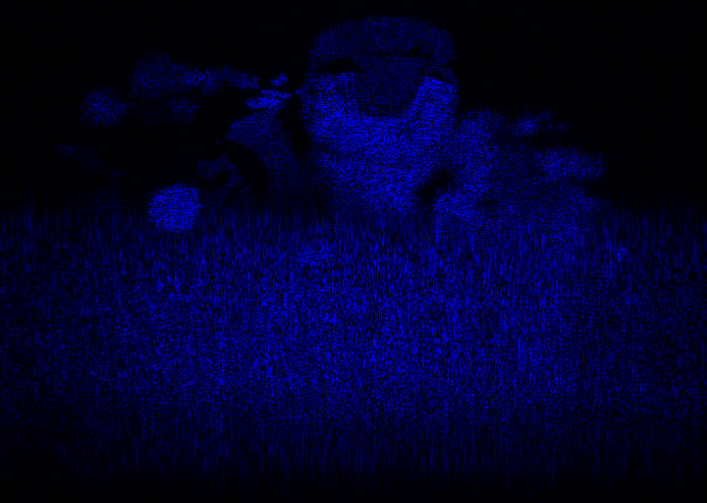
ROI
a)
b)
MLDR method
d)
c)

Slide 4
Point cloud
Depth grid segmentation for each color
Calculate L
Place WRP in the center of depth ranges (created based on L) and record all object points information onto their respective WRP. Then, create the CGH based on Fresnel diffraction.
Repeat for different active area dimension C₁, C₂…..C_{n}
Find L_{R}, L_{G}, L_{B}
No
Repeat for all colors (R,G, B)
Yes
Generate full-color CGH based on L_{R}, L_{G}, L_{B}
a)
b)

Slide 5
L
Temporary
depth-range 1
WRP 1
Depth-range 1
L
Diffraction
CGH
Diffraction
CGH
(i)
(ii)
WRP 1
Depth-range 1
WRP 1
Depth-range 1
L
Temporary
depth-range 2
WRP 2
Depth-range 2
L
Diffraction
CGH
Diffraction
CGH
(iii)
(iv)

Slide 6
L
Temporary depth-range 1
WRP 1
Depth-range 1
WRP 1
Depth-range 1
L
L
Temporary depth-range 2
L
Diffraction
CGH
Diffraction
CGH
Diffraction
CGH
(i)
(ii)
(iii)

Slide 7
L
Temp. Depth range 1
WRP 1
Depth range 1
WRP 1
Depth range 1
L
L
Temp. Depth range 2
L
Diffraction
CGH
Diffraction
CGH
Diffraction
CGH
(i)
(ii)
(iii)
a) Active area size = 2
L
Depth range 1
WRP 1
Depth range 1
WRP 1
Depth range 1
L
L
L
Diffraction
CGH
Diffraction
CGH
Diffraction
CGH
(i)
(ii)
(iii)
b) Active area size = 4

Slide 8
L
Temp. Depth range 1
WRP 1
Depth range 1
WRP 1
Depth range 1
L
L
Temp. Depth range 2
L
Diffraction
CGH
Diffraction
CGH
Diffraction
CGH
(i)
(ii)
(iii)

Slide 9
L
Temporary
Depth-range 1
WRP 1
Depth-range 1
L
Diffraction
CGH
Diffraction
CGH
(i)
(ii)
WRP 1
Depth range 1
WRP 1
Depth range 1
L
Temporary
Depth-range 2
L
L
L
Diffraction
CGH
Diffraction
CGH
(iii)
(iv)

Slide 10
L
Temp. Depth range 1
WRP 1
Depth range 1
WRP 1
Depth range 1
L
L
Temp. Depth range 2
L
Diffraction
CGH
Diffraction
CGH
Diffraction
CGH
(a)
(b)
(c)
a) Active area size = 2
L
Depth range 1
WRP 1
Depth range 1
WRP 1
Depth range 1
L
L
L
Diffraction
CGH
Diffraction
CGH
Diffraction
CGH
(i)
(ii)
(iii)
b) Active area size = 4

Slide 11
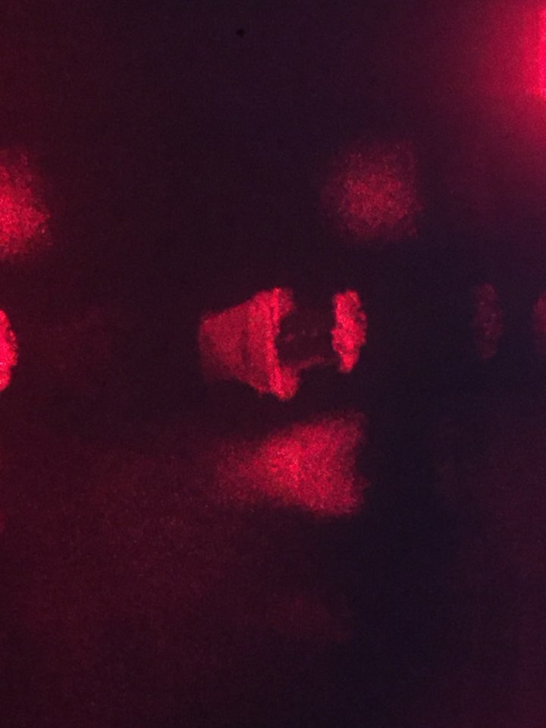
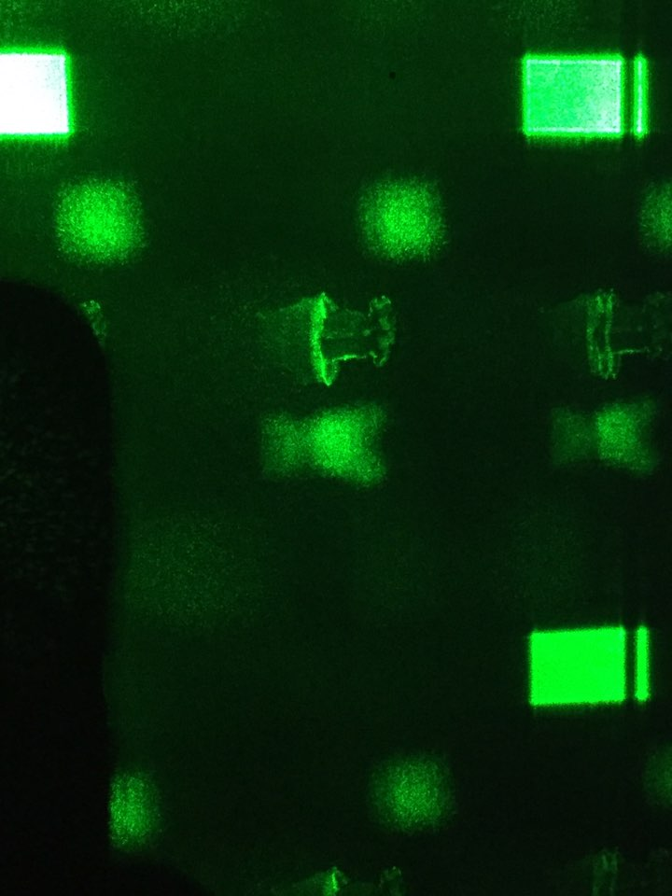
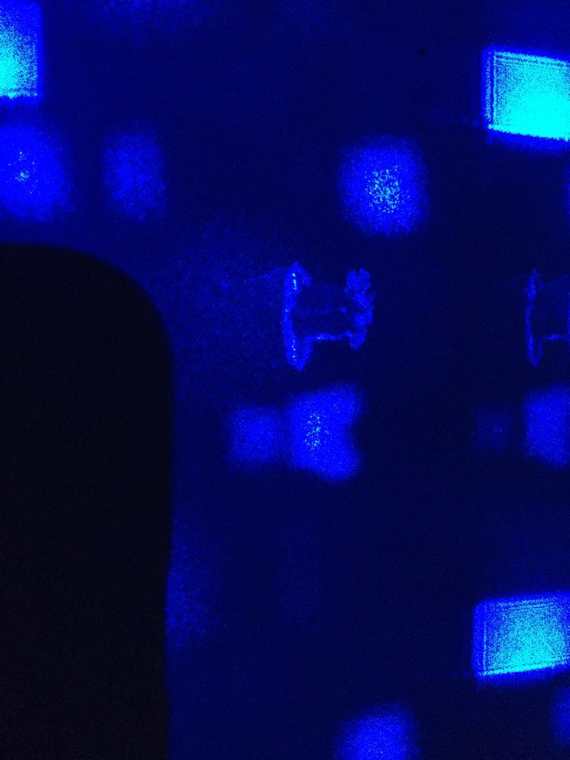
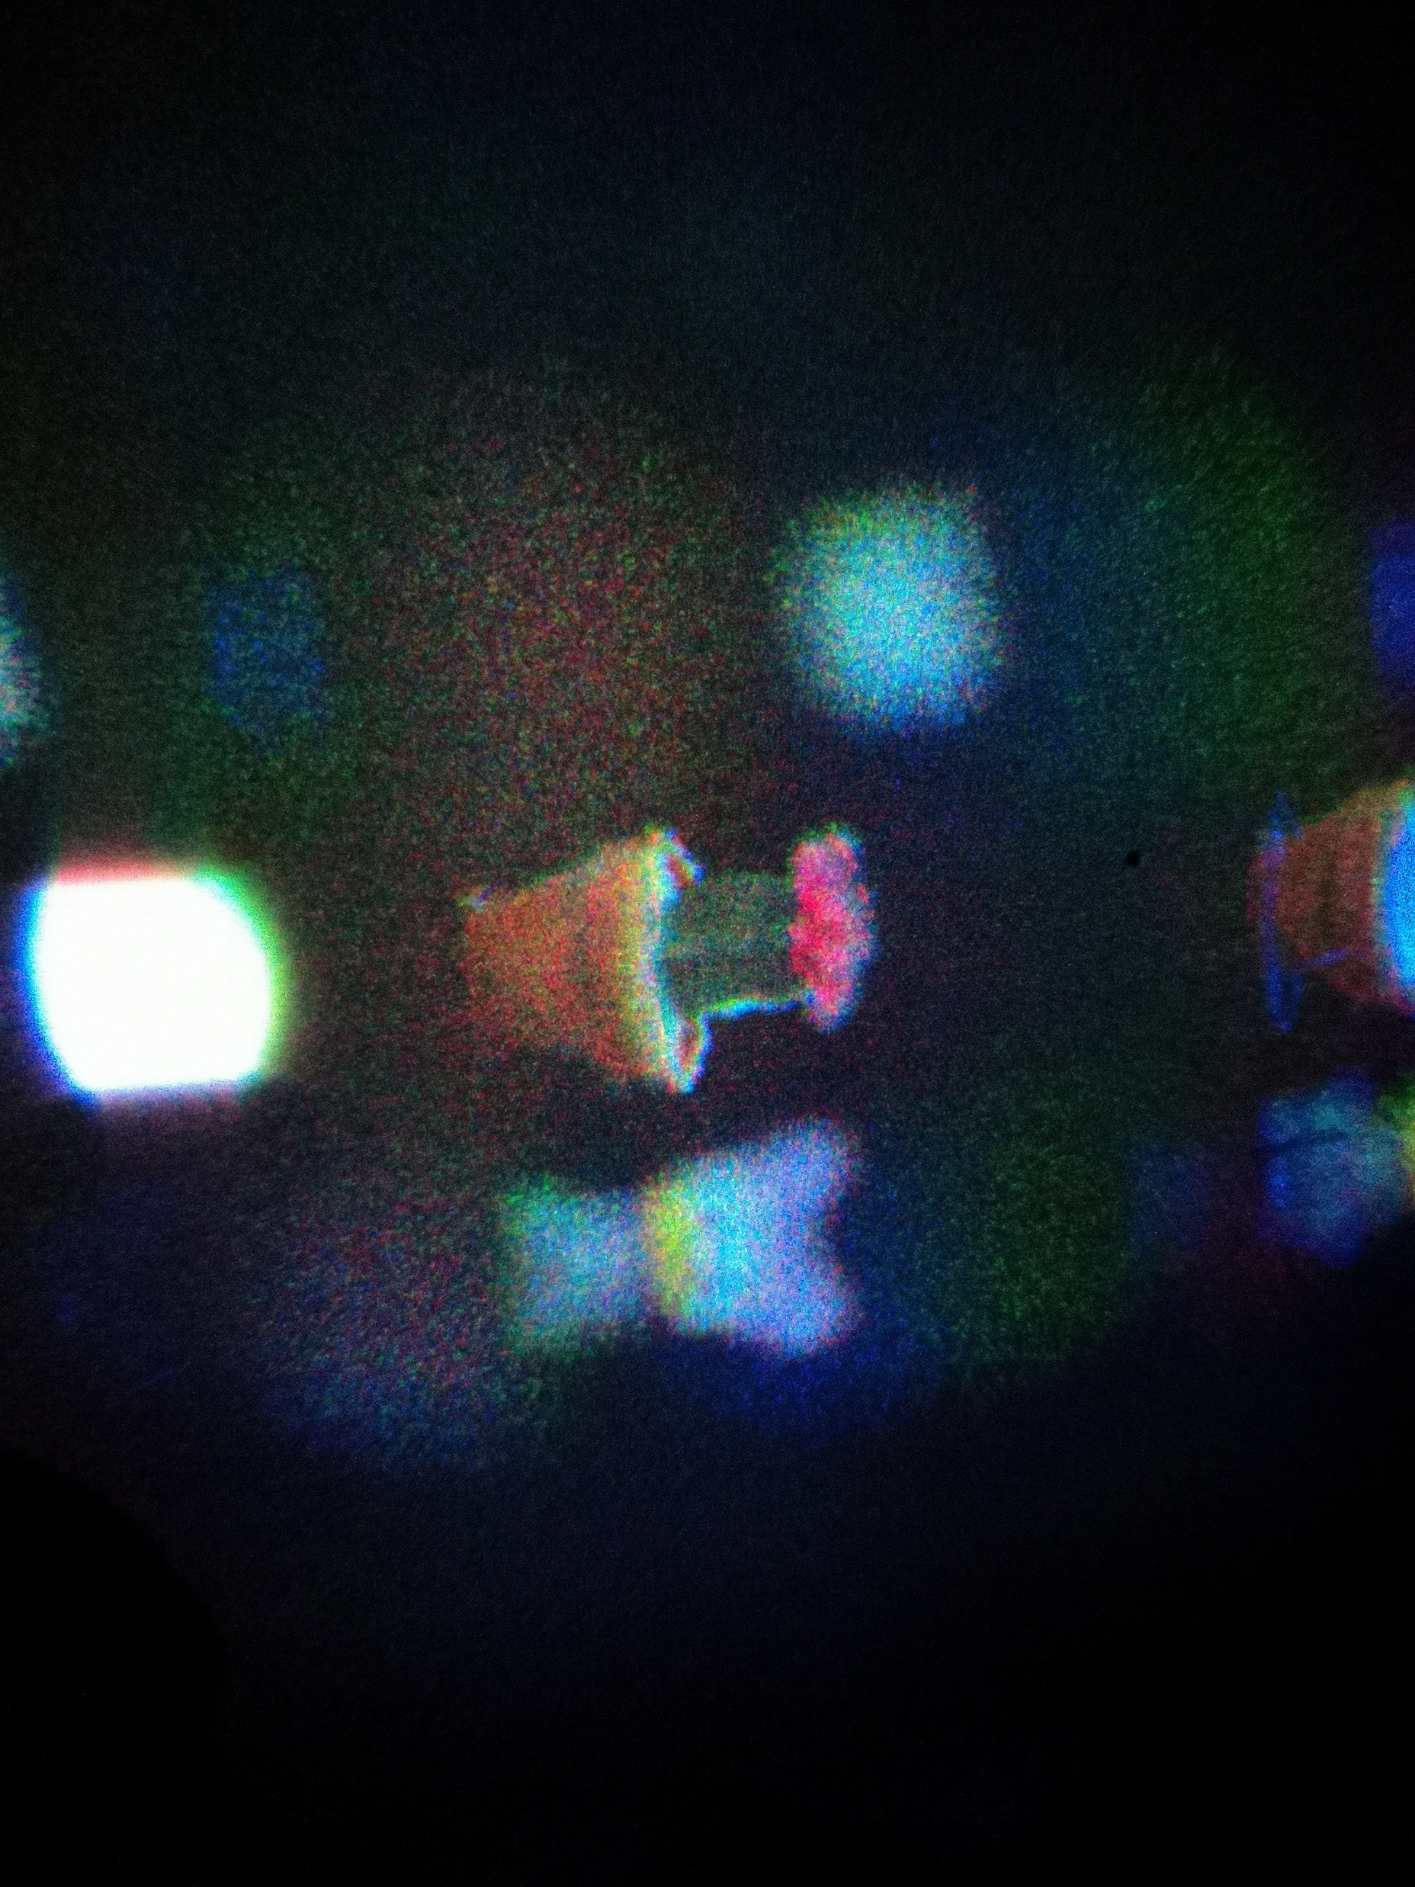
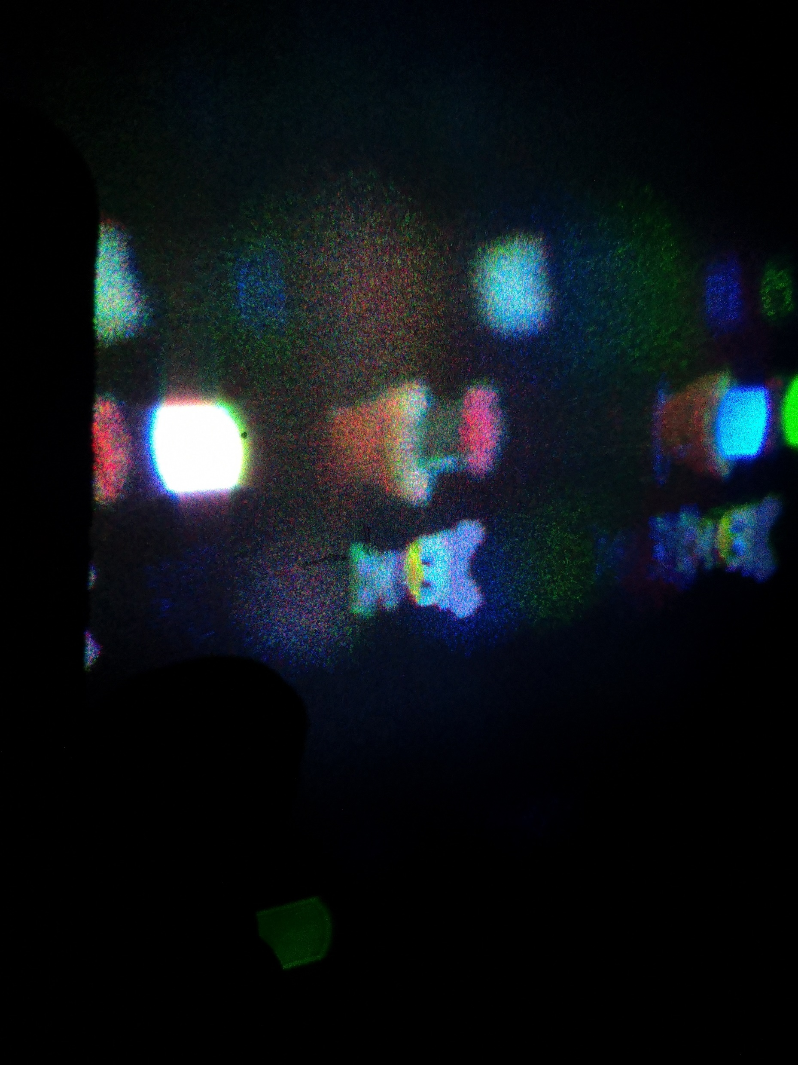
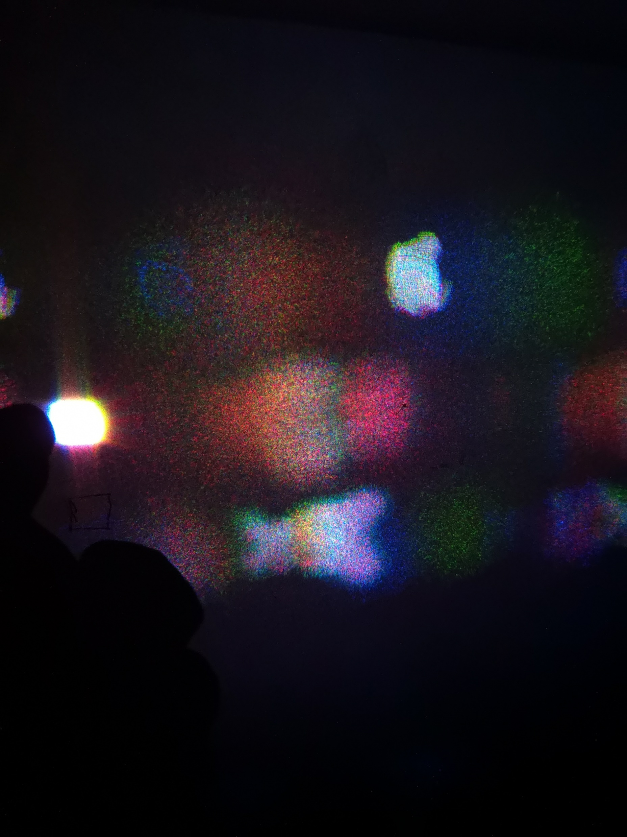
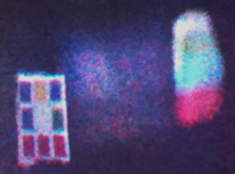
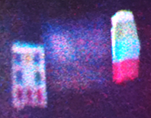
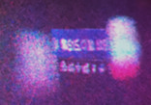
SCENE 1 (1024 X 1024)
a)
b)
c)
a)
b)
c)
d)
e)
f)

Slide 12
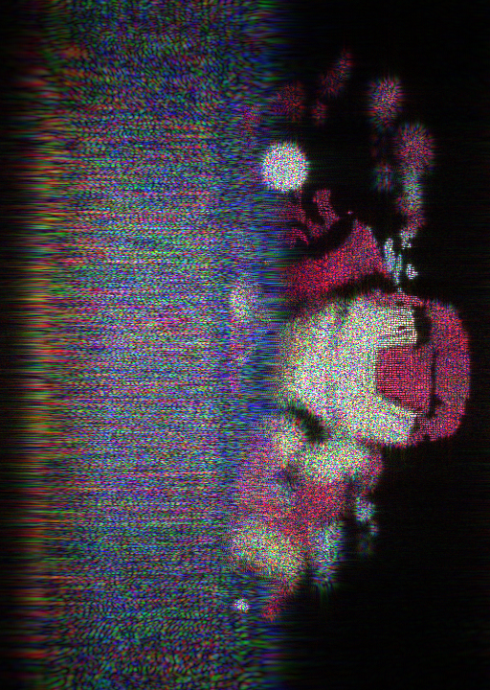
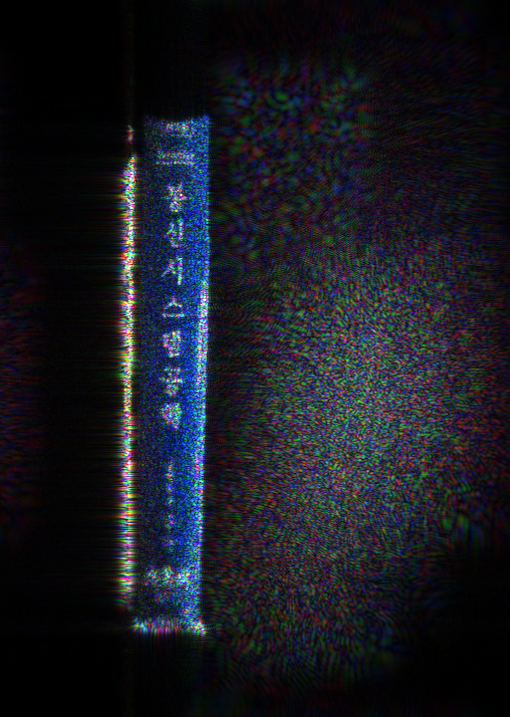

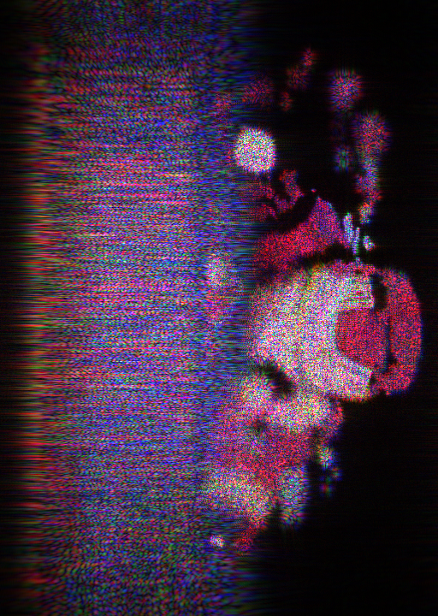
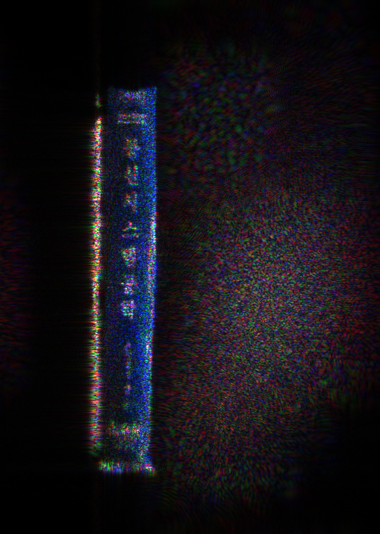
PSNR = 14.22
PSNR = 18.76
a) Original Scene 3
c) Conventional M-WRP method
PSNR = 15.34
PSNR = 18.41
b) Original Scene 4
d) Proposed MLDR method

Slide 13
a)
b)
c)
d)

Slide 14
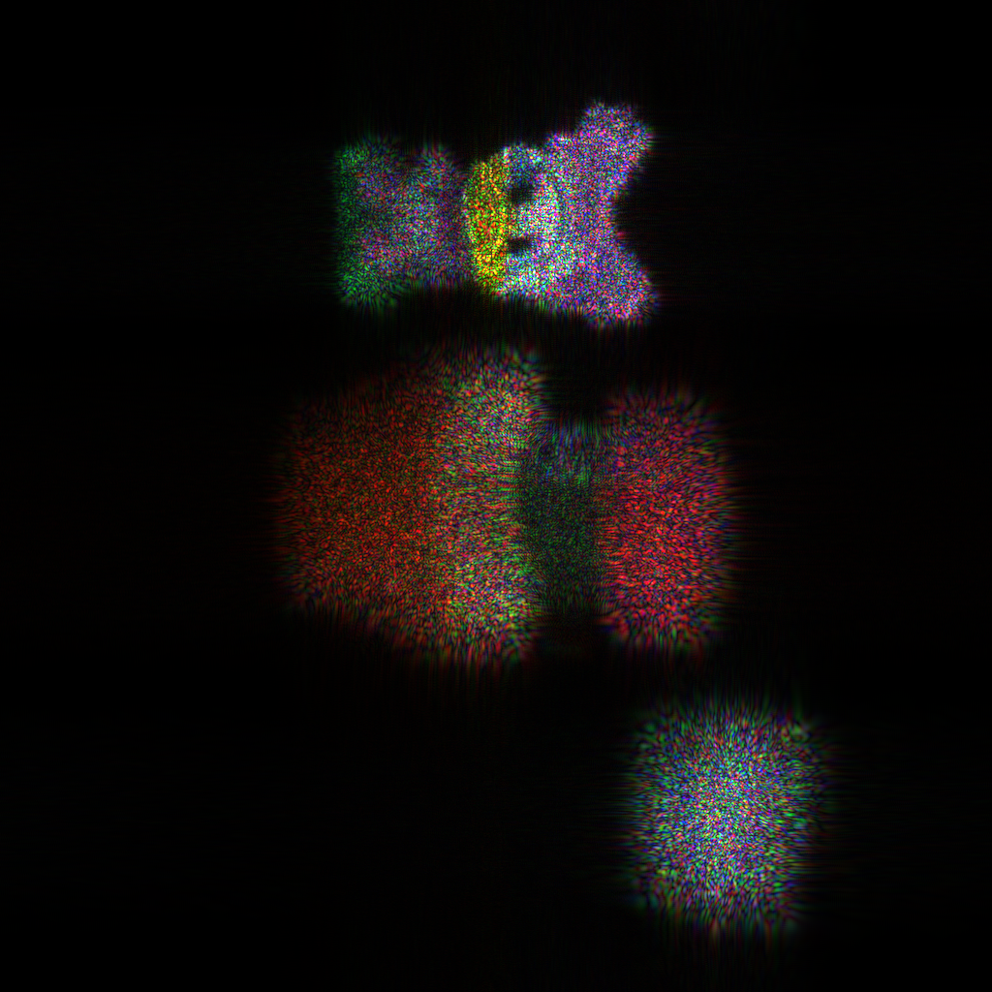
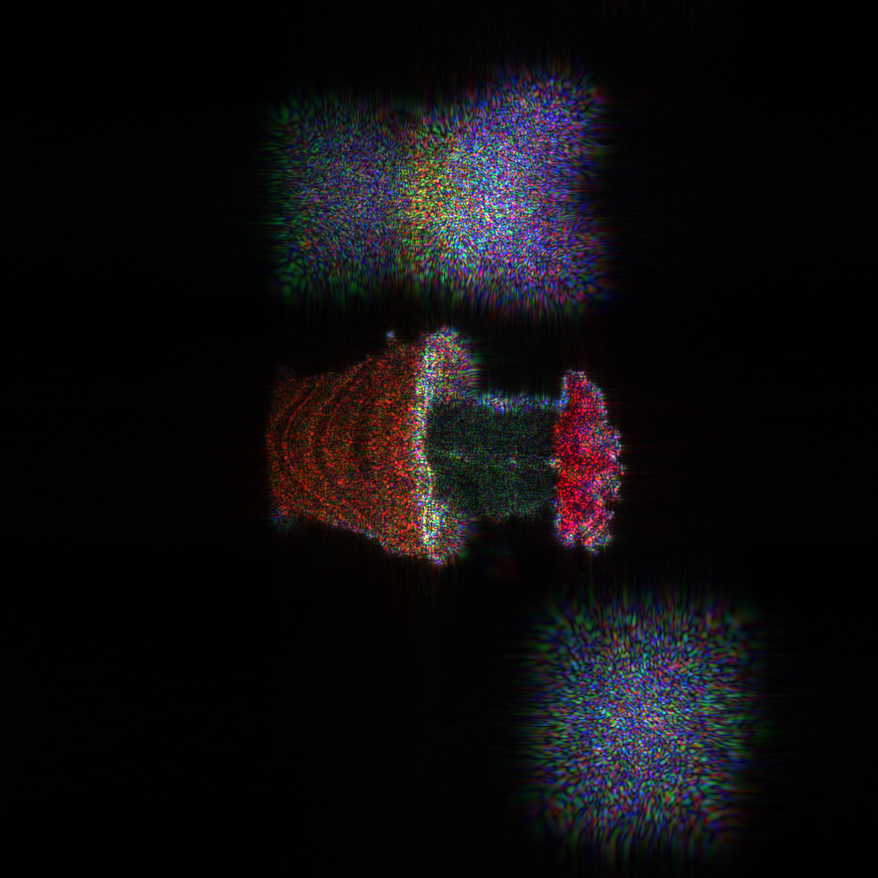
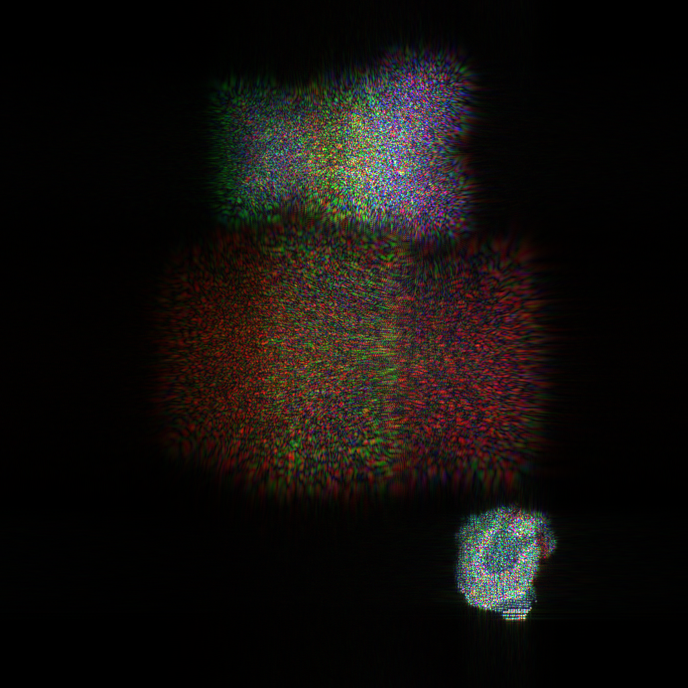
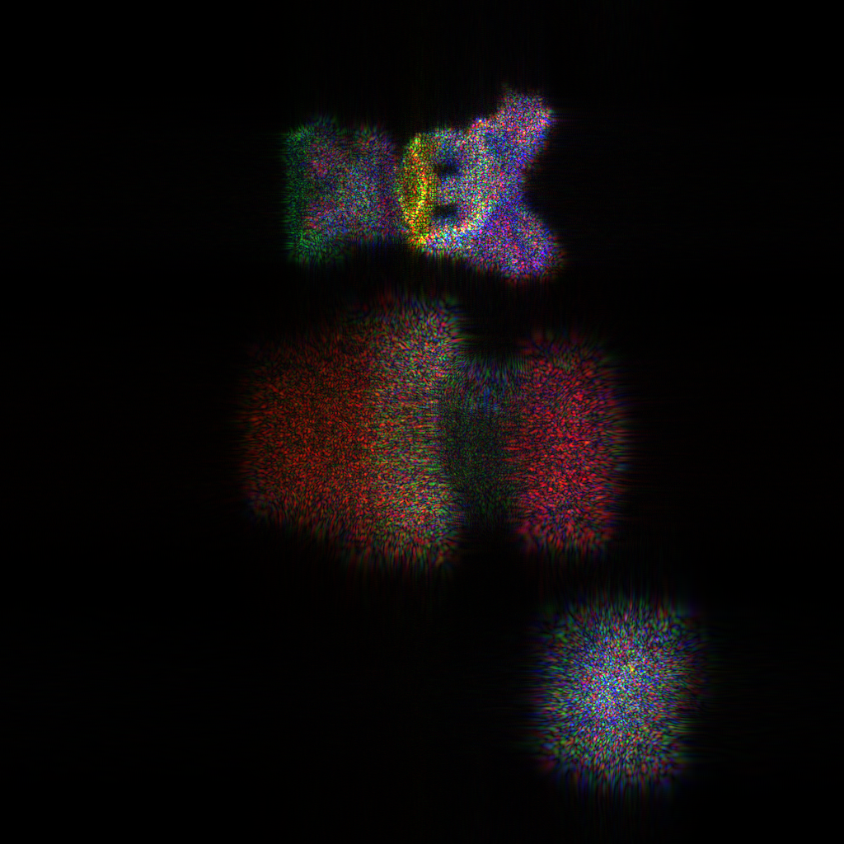
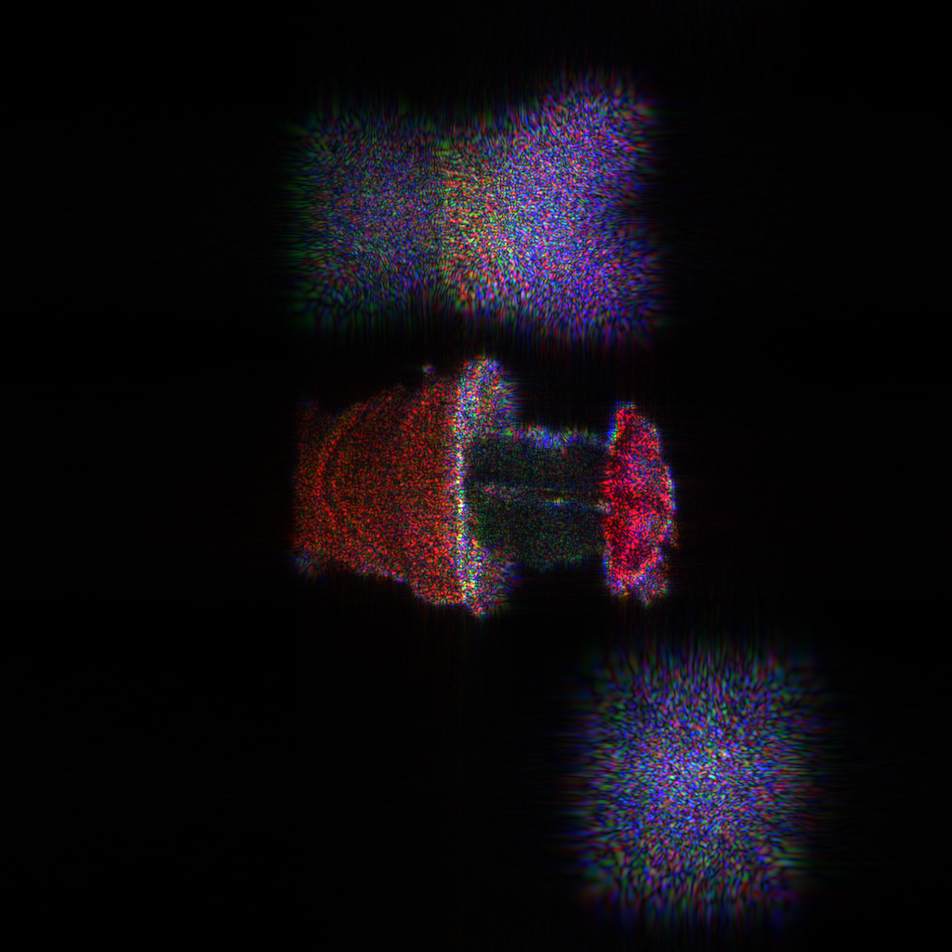
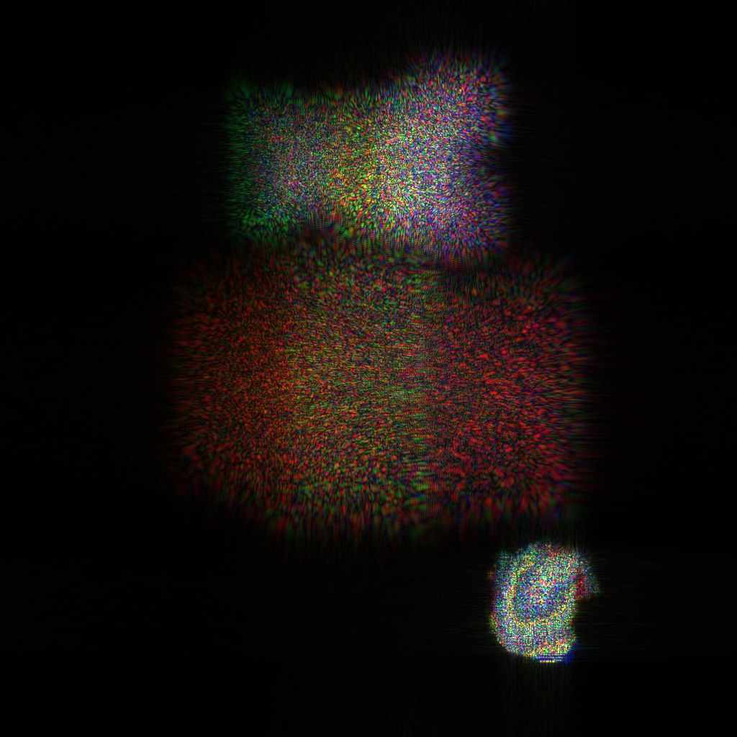
SCENE 1v3 (1024 X 1024)
28.15%
Conventional
PSNR = 14.90 dB
PSNR = 17.40 dB
PSNR = 14.06 dB
PSNR = 15.37 dB
PSNR = 17.25 dB
PSNR = 14.31 dB
a)
b)
c)
proposed
Notes:
three_object obj(:,1) = (obj(:,1)+0.0003)*2.5 ; obj(:,2) = obj(:,2) *2.5; obj(:,3) = obj(:,3)*110;

Slide 15
SCENE 1v3 (1024 X 1024)
28.15%
PSNR = 14.90 dB
PSNR = 15.37 dB
PSNR = 17.40 dB
PSNR = 17.25 dB
PSNR = 14.06 dB
PSNR = 14.31 dB
a) M-WRP method
b) MLDR method
Notes:
three_object obj(:,1) = (obj(:,1)+0.0003)*2.5 ; obj(:,2) = obj(:,2) *2.5; obj(:,3) = obj(:,3)*110;

Slide 16
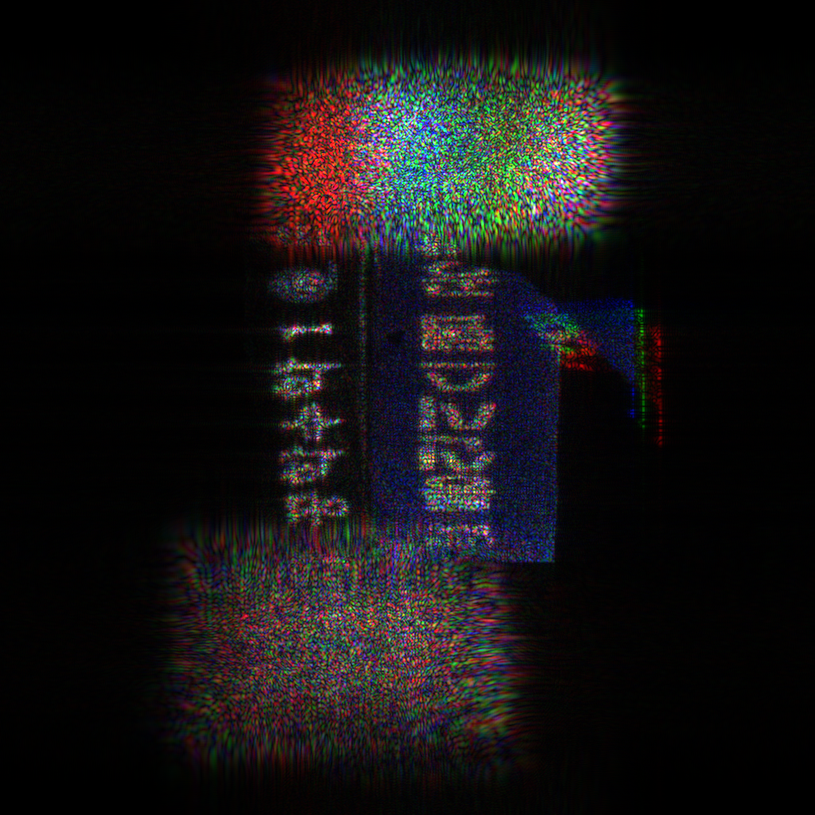
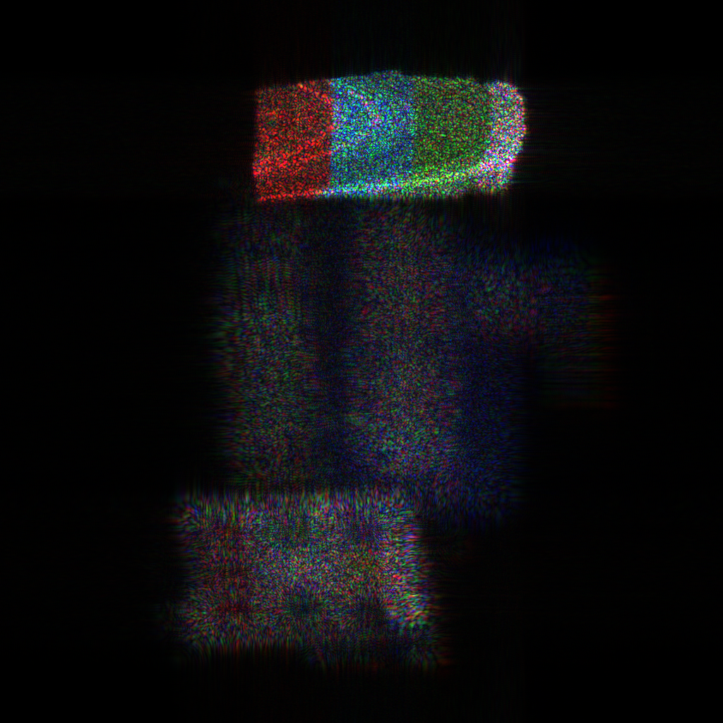
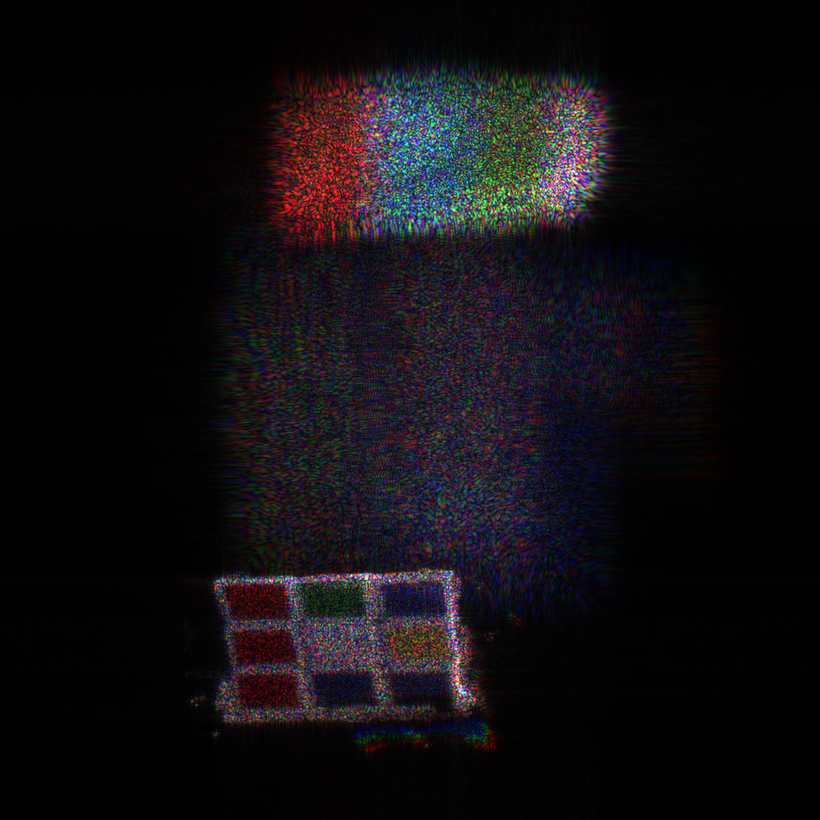
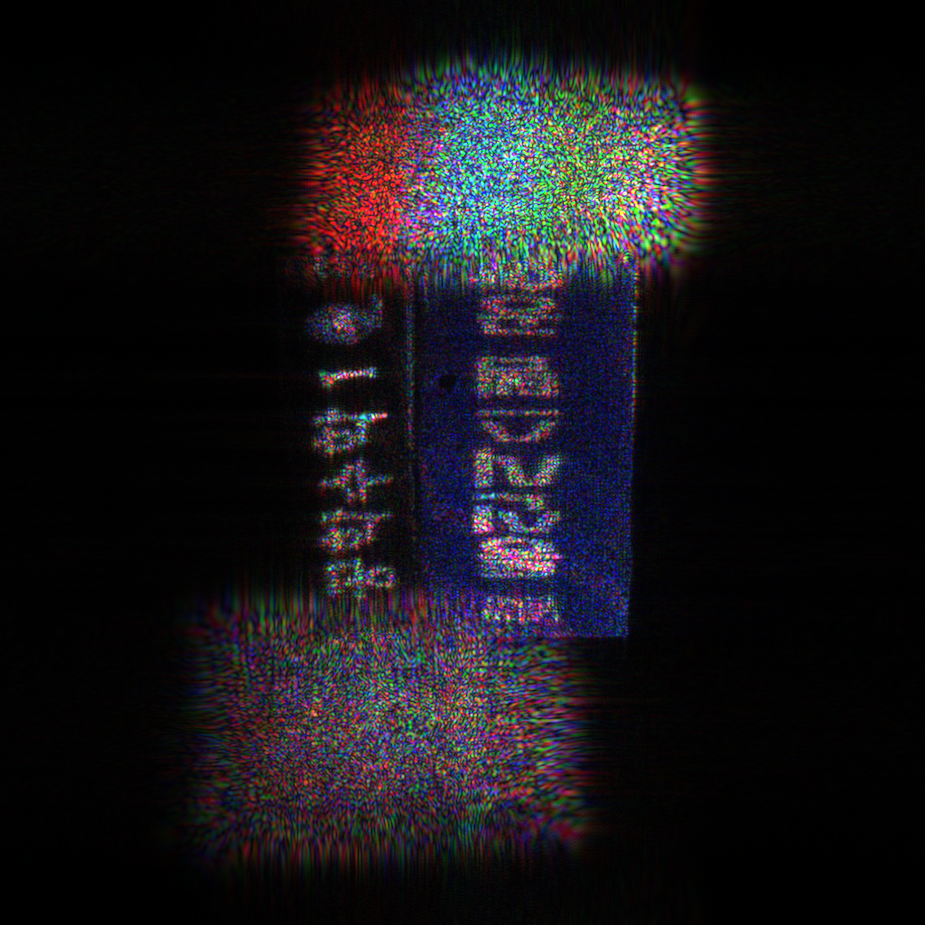
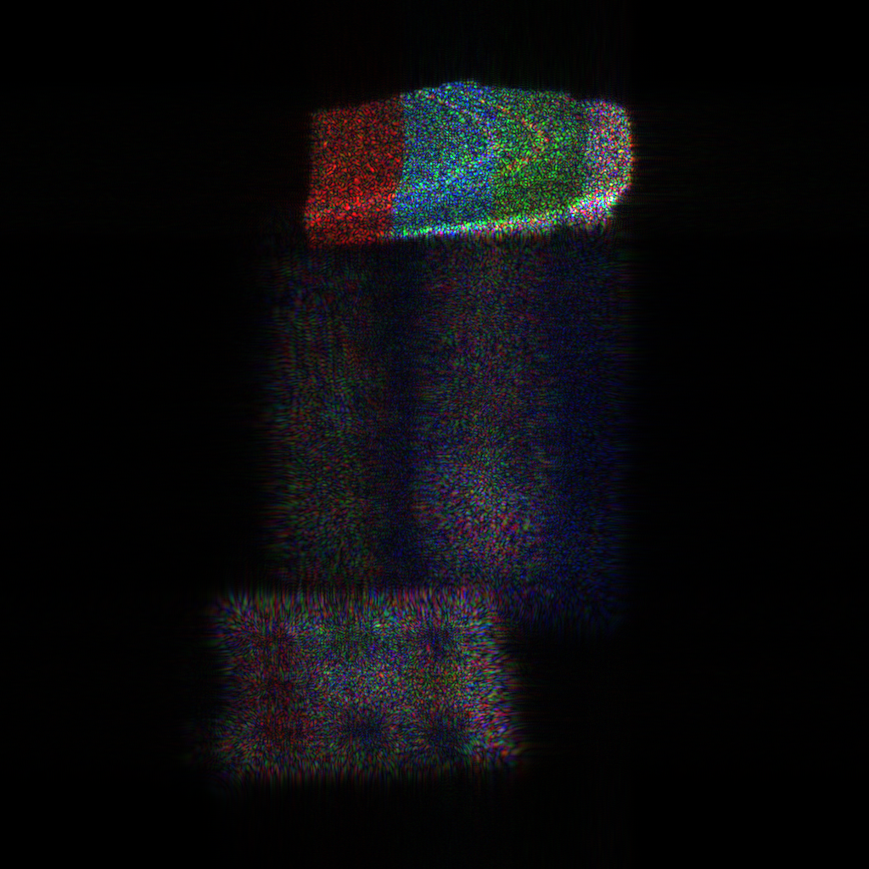
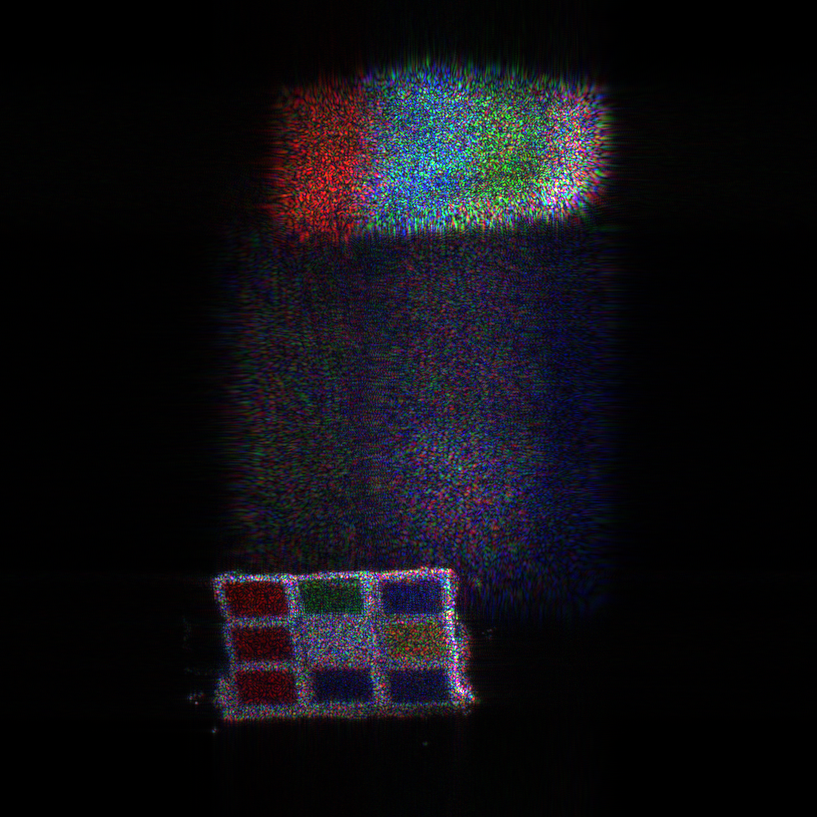
SCENE 2 (1024 X 1024)
15.08%
Conventional
PSNR = 17.59 dB
PSNR = 12.92 dB
PSNR = 14.55 dB
PSNR = 16.44 dB
PSNR = 13.03 dB
PSNR = 14.19 dB
a)
b)
c)
proposed
Notes:
D:\Mathlab\wrp\finalsad_life0_0.000008000\720X512\obj_depth0.054478\d_0.23\layers_96\CPU_sifat_convensionalMWRP_v2
sad_life obj(:,1) = ((obj(:,1)-0.16 )/300); obj(:,2) = (obj(:,2)+2.25 )/2200; obj(:,3) = (obj(:,3))/20;
d = 0.23;
Book = 1
Cup = 32
Book=45
% crop =[230 270 200 250]; %% book
% crop =[110 1 400 200]; %cup

Slide 17
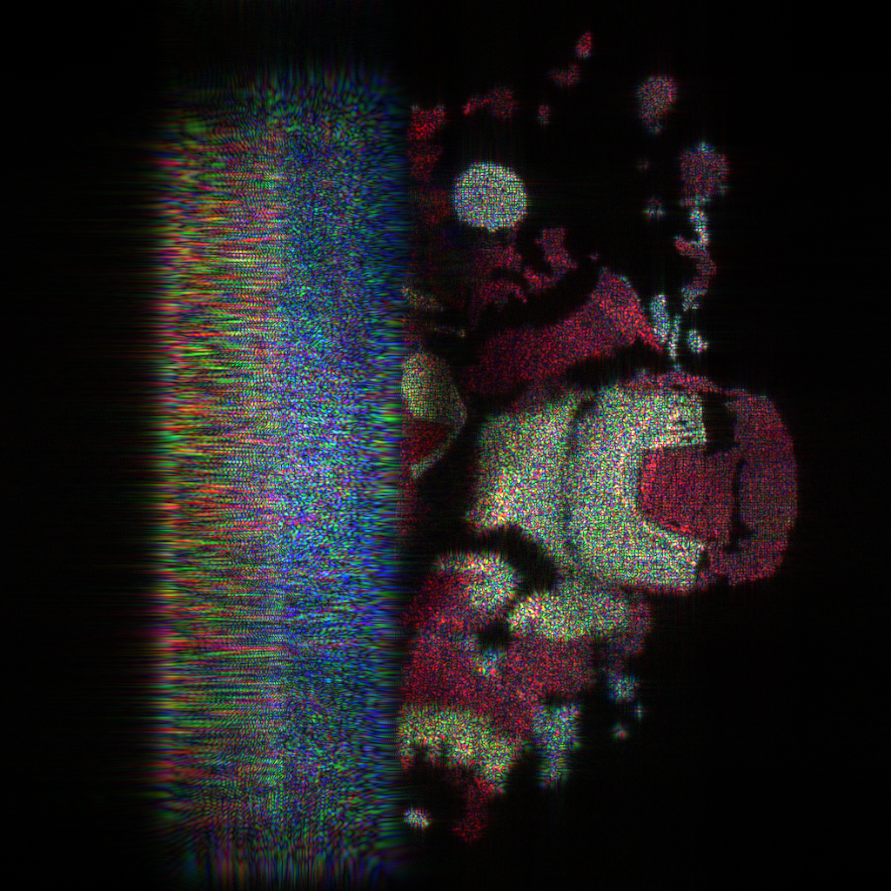
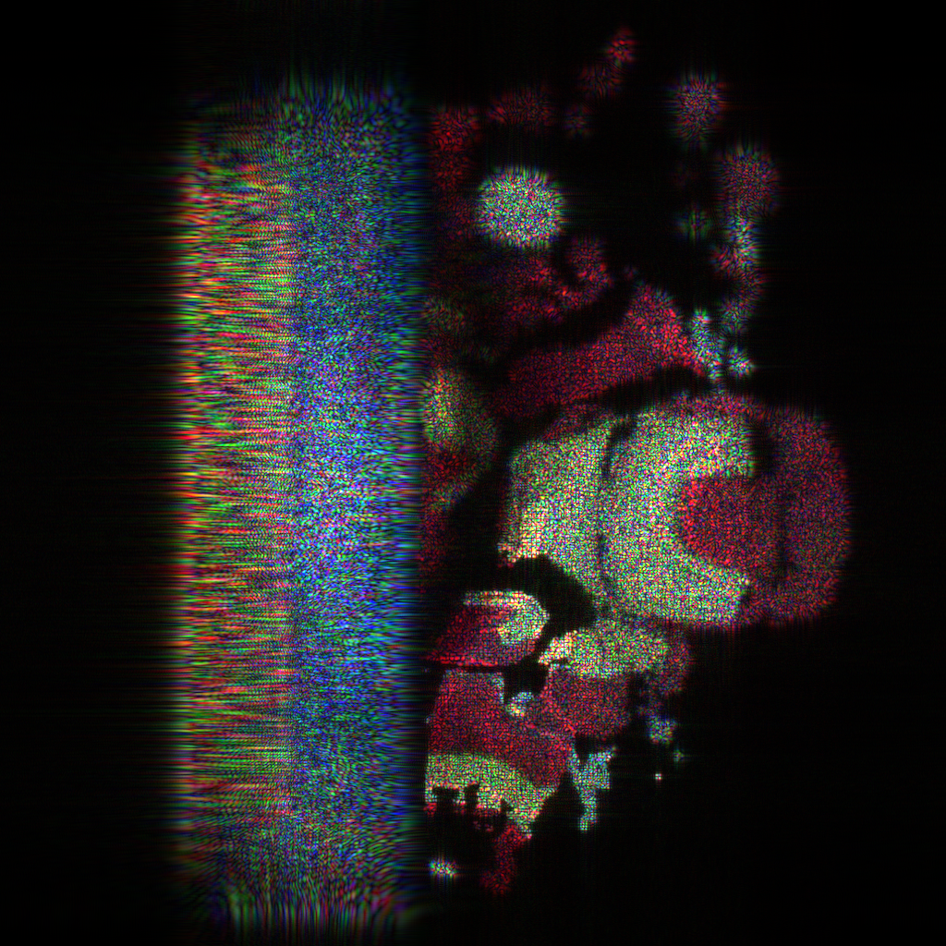
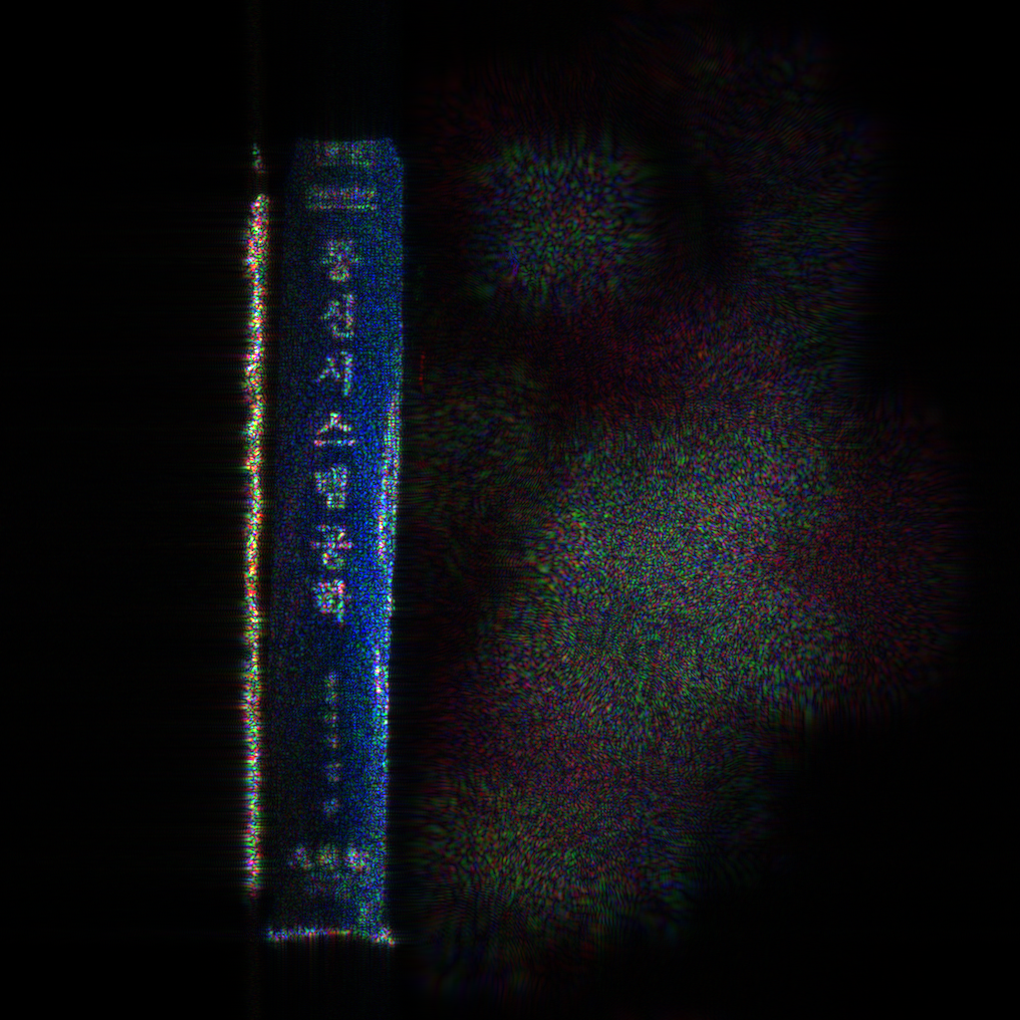
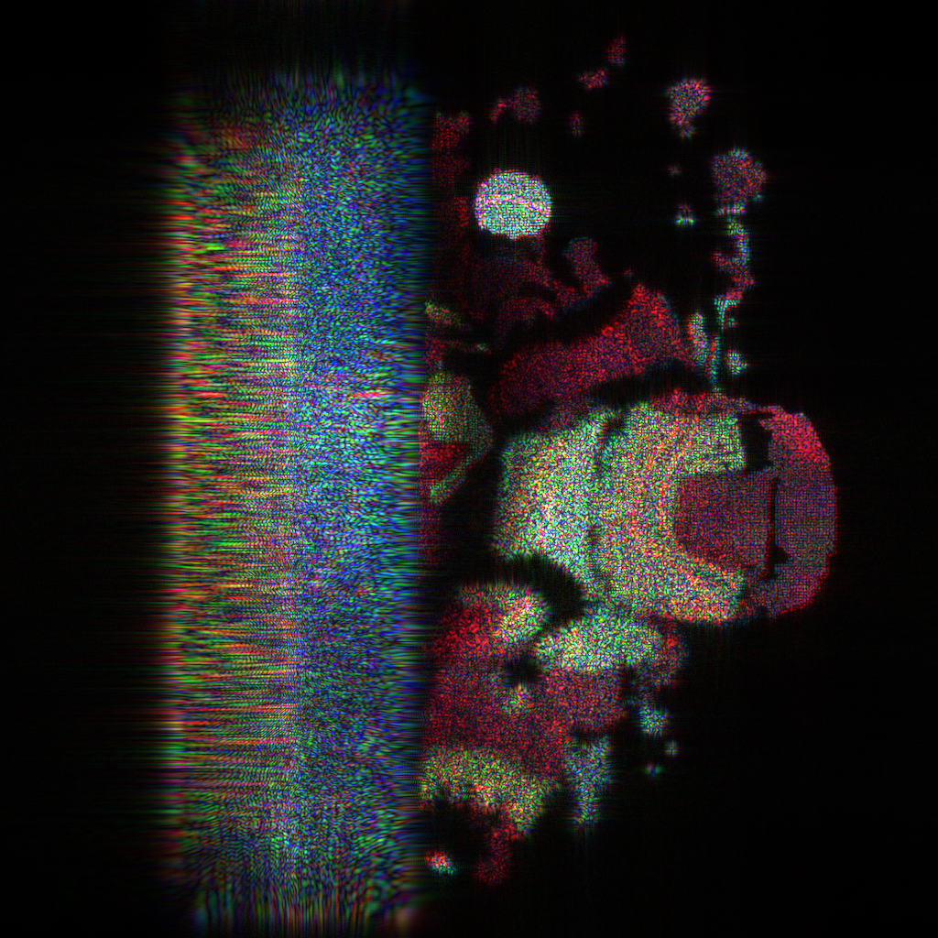
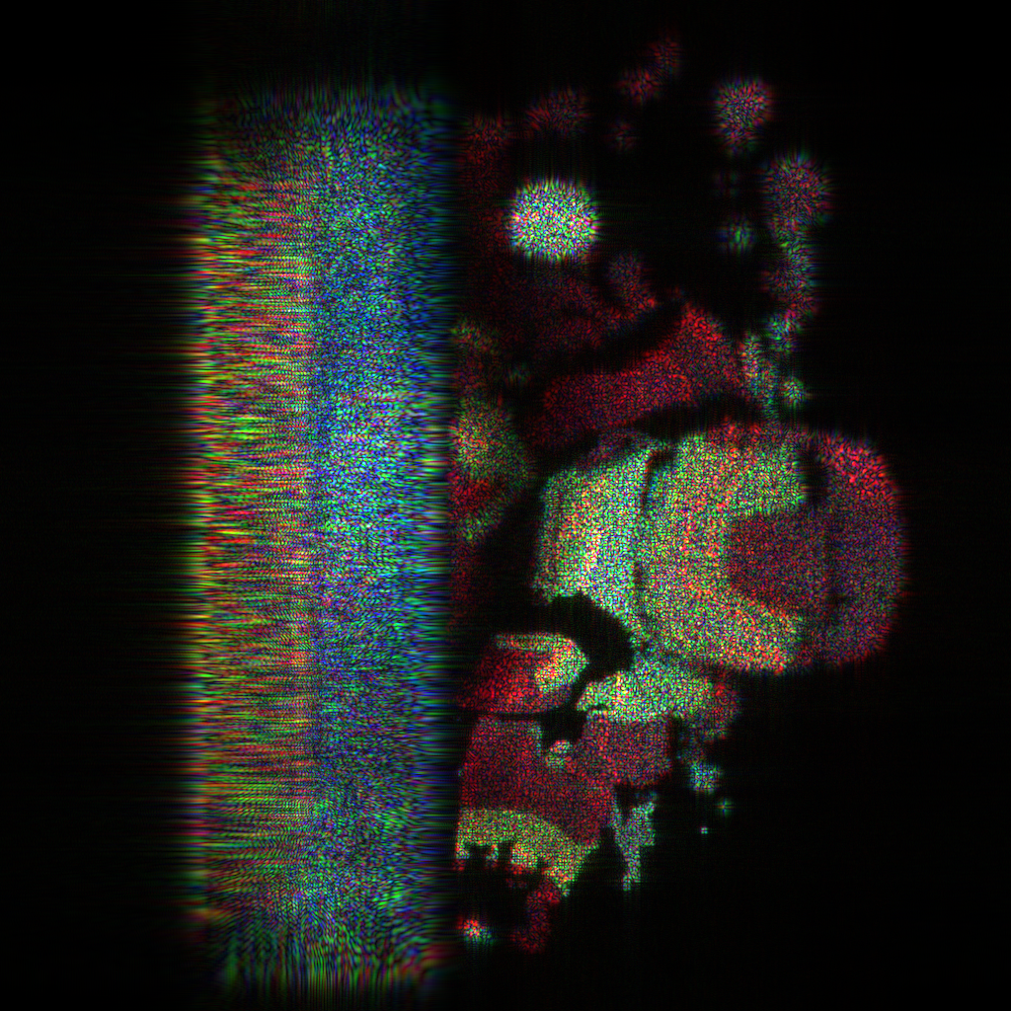
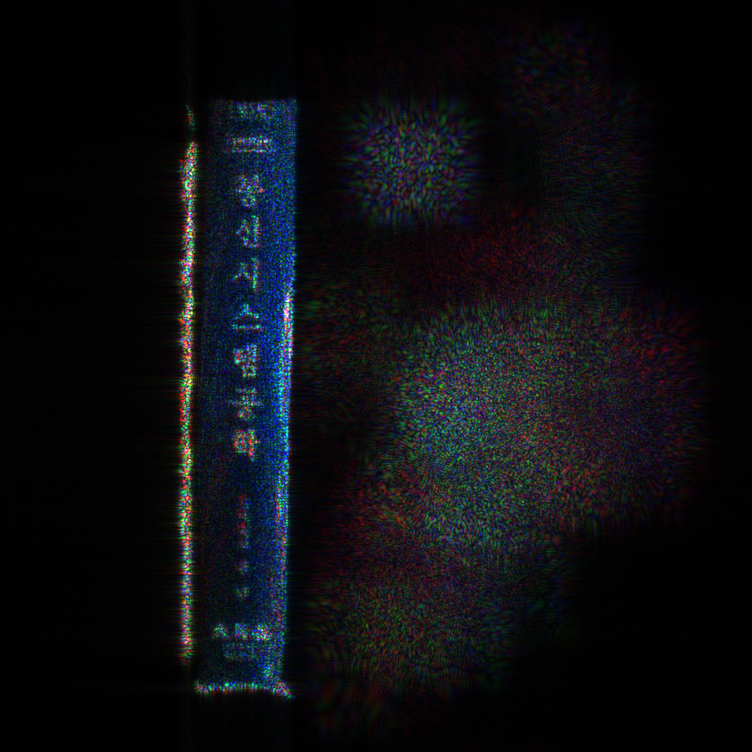
SCENE 3 (1024 X 1024)
18.1%
Conventional
PSNR = 16.78 dB
PSNR = 13.79 dB
PSNR = 16.48 dB
PSNR = 15.27 dB
PSNR = 15.39 dB
PSNR = 15.99 dB
a)
b)
c)
proposed

Slide 18
Notes:
D:\Mathlab\wrp\finalfour_items_0.000008000\720X512\obj_depth0.037872\d_0.15\layers_104\CPU_sifat_convensionalMWRP_v2
four_items obj(:,1) = ((obj(:,1)-0.13 )/420); obj(:,2) = (obj(:,2) )/1200; obj(:,3) = (obj(:,3))/18; max(obj) min(obj) % % % max(obj) - min(obj) obj_depth = max(obj(:,3)) - min(obj(:,3)) d = 0.15;
Cube = 56
Book2 = 37
Hen= 39
Cup=24

